Slide 1
Teach Yourself How to Program
Chad Haefele
Emerging Technologies Librarian UNC Chapel Hill cHaefele@email.unc.edu

Slide 2
;
Notes:
About me – this is the reason I’m a librarian.
-not a full time programmer, or even an excellent one. Not fluent, but conversant. That's what you need to be.

Slide 3
?
Notes:
What about you?

Slide 4
How much of a coder are you?
I’m a complete beginner
I know some HTML, but that’s about it
I’ve wrangled a line or two of more advanced code in my time
I’ve plugged a database into some code on the web
I could write a Facebook clone in my sleep

Slide 5
What language do you want to learn?
PHP
JAVA
Objective C
Something else
I don’t know / don’t have a preference

Slide 6
Is HTML/CSS a programming language?
<p><a href="/digitalprojects.html">Digital Collections</a></p>
<p style="padding: 10px 0 10px 0;"><a href="http://calendar.lib.unc.edu/">Book a Room</a></p>
Notes:
Markup. Generally programming languages have some logic to them. If/else, loops, etc.

Slide 7
What’s it like to learn a programming language?
Happiness and rainbows!
It was OK I guess
Pretty frustrating
I threw my computer out the window
All of the above
Notes:
-Alternately frustrating and extremely rewarding

Slide 8
It’s all about the syntax
PHP:
echo “Hello world!”;
Javascript:
document.write(“Hello world!”);
Notes:
Basic structures like if, else, other loops go across languages too.

Slide 9
What do you want to code?
Interactive websites
Mobile apps
Desktop programs
Notes:
What you want to do influences how you’ll do it

Slide 10
Server vs client on the web
PHP: Server side
Code runs on a server somewhere
Generally runs before or while the webpage loads
More secure
Javascript: Client side
Code runs on the user’s computer
Generally runs after the webpage has loaded
Less secure
Notes:
Examples: displaying the current time on a webpage. JS is used for things like animated bits on webpages, menus, etc. Generally server side is much faster too. Example: syncronizing clocks. Server side isn’t as easy to just play with.

Slide 11
Android apps
Java
Install the SDK: http://developer.android.com/sdk/index.html
Write code using a program like Eclipse
Free to publish in Google Play
Notes:
This is about setting goals, knowing what tools you need to learn before you get started. Have an endpoint in mind, but a realistic one.

Slide 12
Iphone & ipad apps
Objective C
Install Xcode 4: https://developer.apple.com/devcenter/ios/index.action
$100/year to publish apps, or test for free
Notes:
Free option runs apps on the mac only

Slide 13
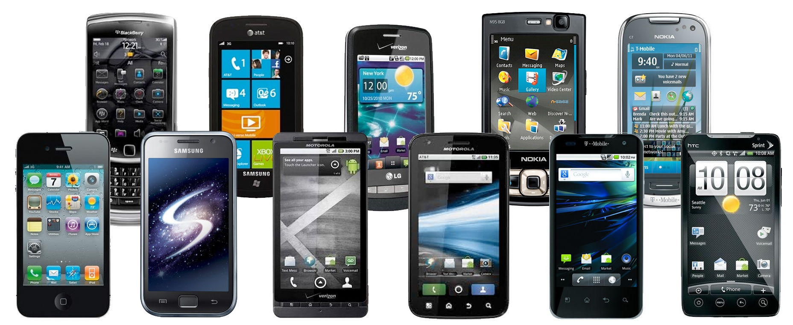
Interactive & mobile websites
HTML & CSS: Mark up your document
PHP: Interact with databases or any other server part
Javascript: Make your UI fancy
Notes:
PHP here is my recommendation – could realistically be anything
PHP
Python
Javascript
Ruby
ASP
Bonus: SQL

Slide 14
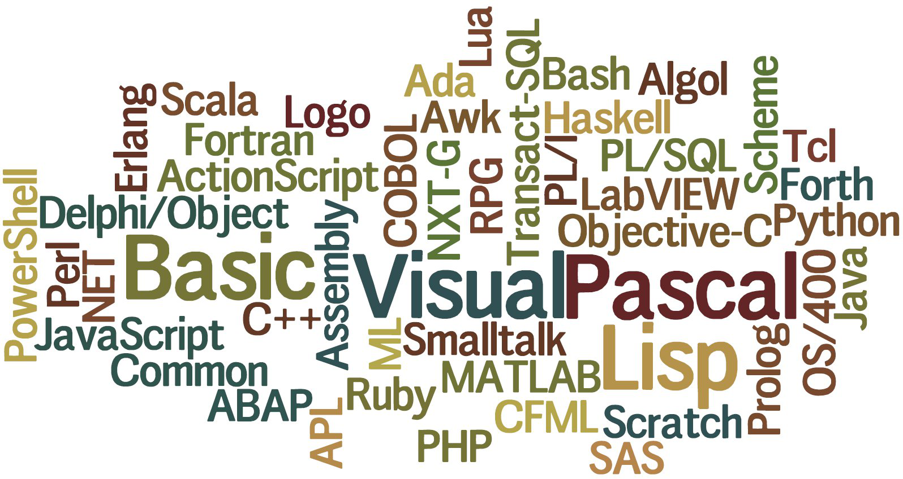
Desktop programs
Notes:
Realistically, go with Java for cross-compatibility.

Slide 15
Ok, so how do I learn this stuff?
Notes:
MOOCs
Other websites
Books
Google

Slide 16
Notes:
-CS101 – David Evans, U of VA prof
-CS253 (web development) - Steve Huffman, founder of Reddit & Hipmunk

Slide 17
Notes:
Udacity is largely python. But remember that syntax is transferrable! Others include Coursera with more traditional lecture format

Slide 18
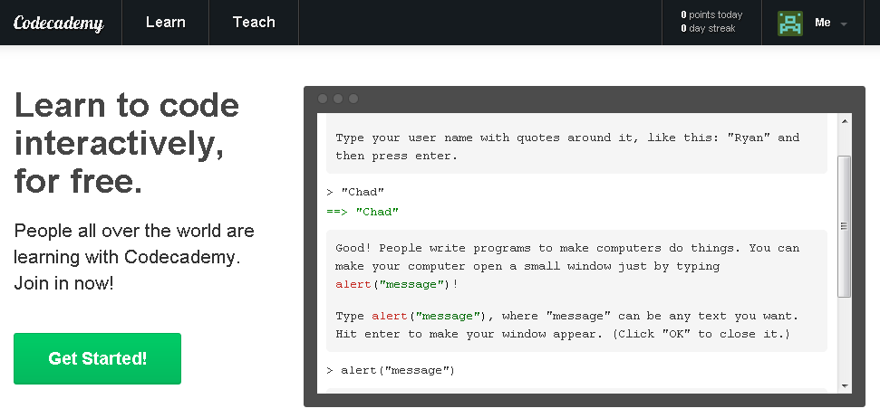
Notes:
Javascript, php, python, ruby, more

Slide 19
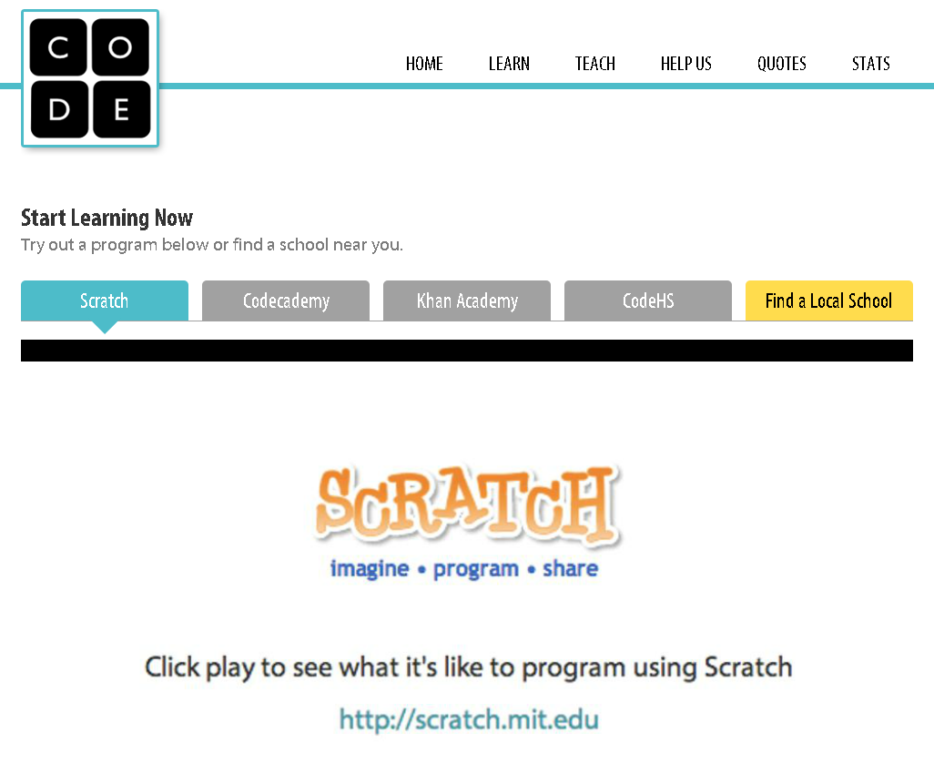
Notes:
More of a launchpad or list of links

Slide 21
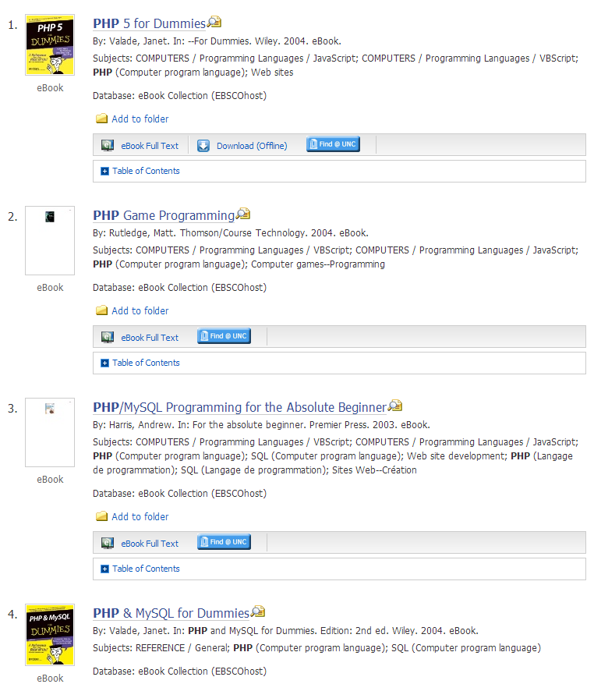
NC Live eBooks
Notes:
Search for PHP

Slide 22
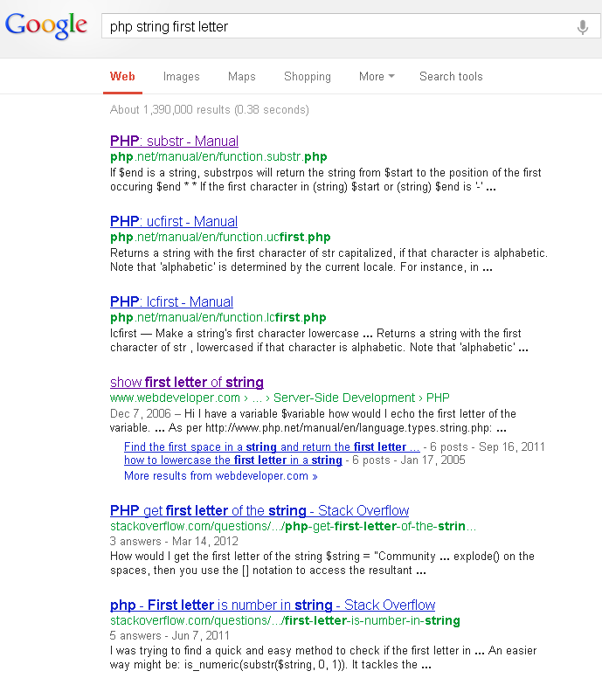

Slide 23
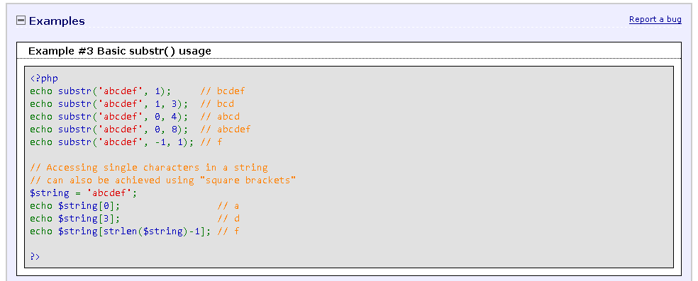

Slide 24
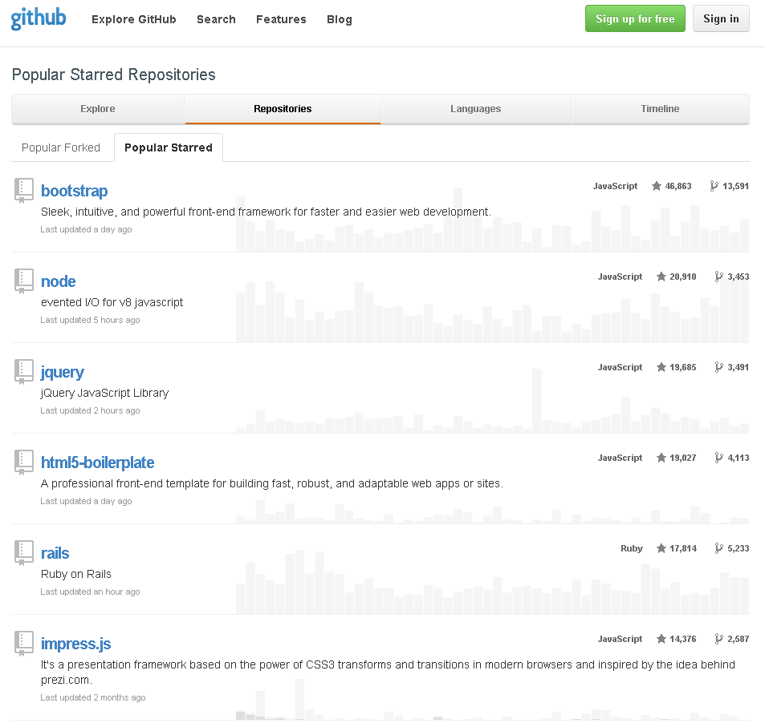
Notes:
More in-depth example: twitter API libraries

Slide 25
What tools can I use to build something?
Notes:
Personally, I say start with PHP or javascript
Android app inventor
Appfog.com or other hosting
Frameworks

Slide 26
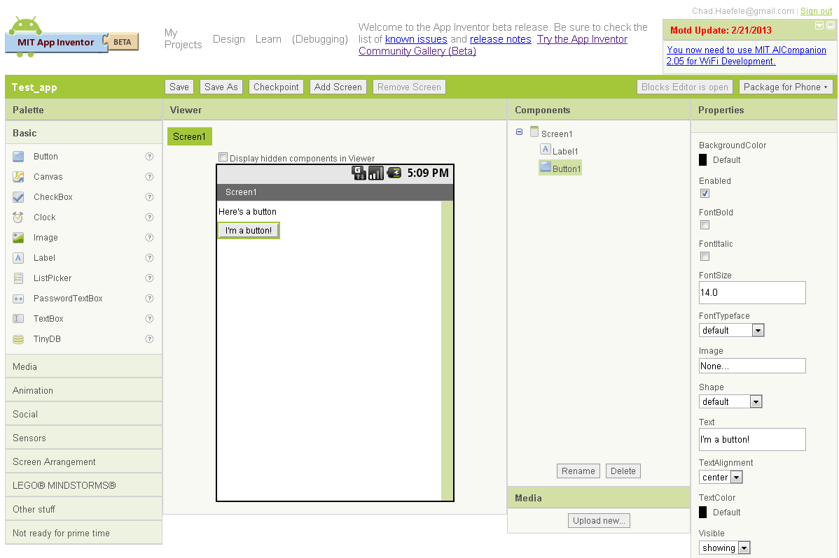
Notes:
Beginner level – perfect your logic, build confidence

Slide 27
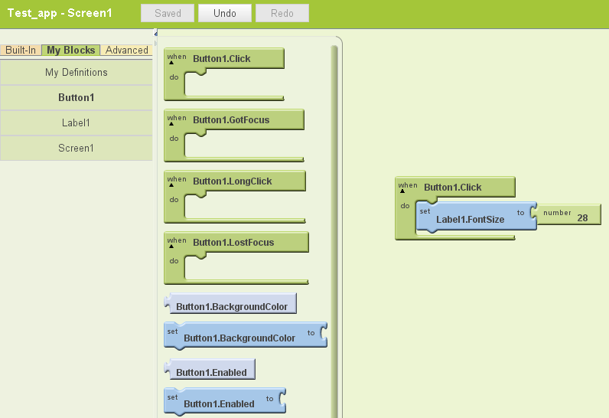

Slide 28
Notes:
Intermediate – start writing your own code

Slide 29
Notes:
Advanced – own your hosting

Slide 30
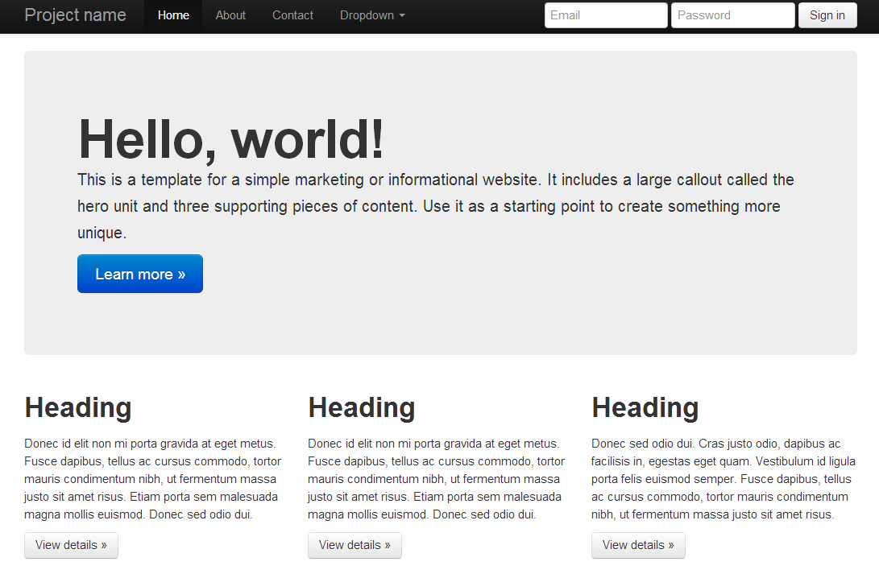

Slide 31
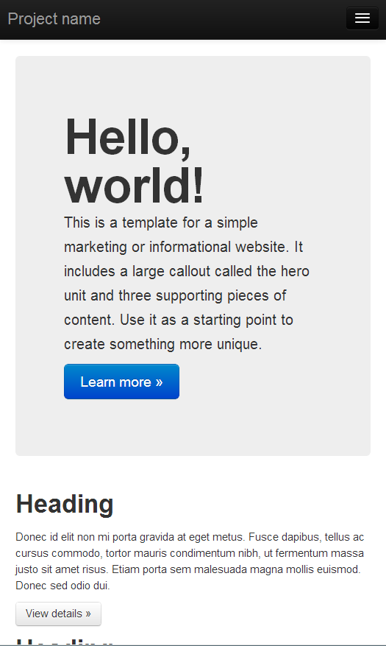

Slide 32
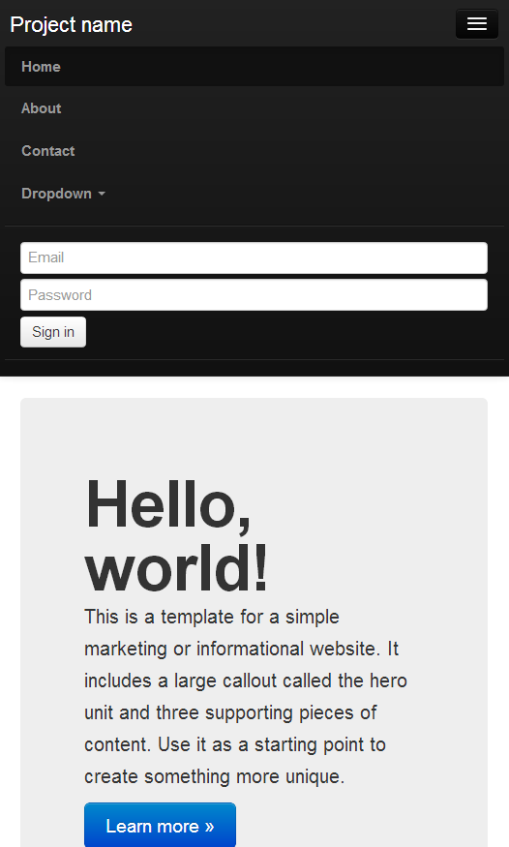

Slide 33
Putting the pieces together
Notes:
Pick a project
Set up a self-hosted Wordpress blog, and customize it (php, SQL, js, html, css)
Build an interactive form (citation builder?)
Shopping list demo
How does php work inside HTML?
How does javascript work inside HTML?

Slide 34
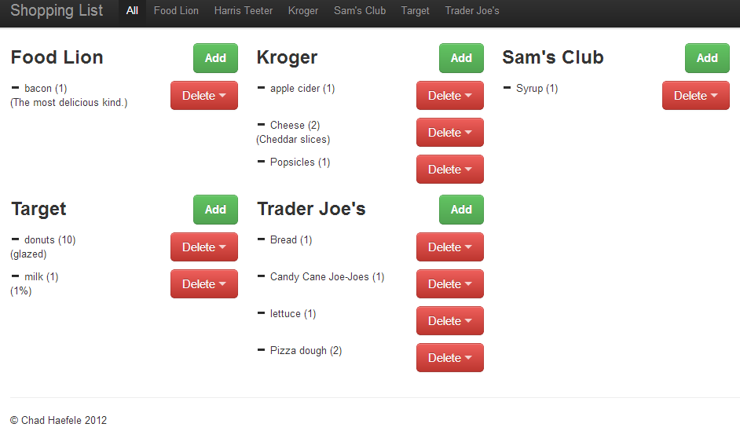
Notes:
This uses php, HTML, css (bootstrap) & sql

Slide 35
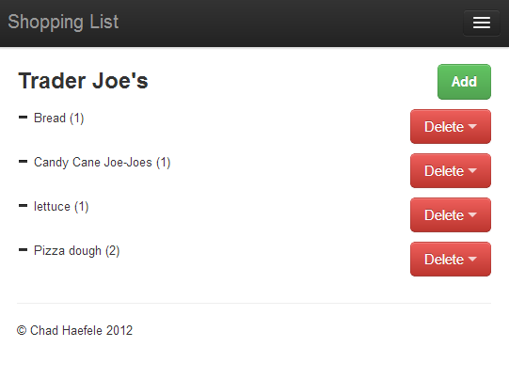

Slide 36
Using php with html
Notes:
Remember that this is a server-side language. Use it to insert dynamic content. (this is a poor example, but simple)

Slide 37
Using javascript with html
Notes:
Client-side

Slide 38
Go forth and code.
Slides & Links: www.hiddenpeanuts.com/tnt
Chad Haefele
cHaefele@email.unc.edu
Notes:
Pick a project
Set up a self-hosted Wordpress blog, and customize it (php, SQL, js, html, css)
Build an interactive form (citation builder?)

